Slide 1
Air Pollution Project
Paulette Petracco, Rachel Puzycki, Lauren Ables-Torres, Savanna Bosworth

Slide 2



Air Pollution
Air Pollution: Everything You Need to Know
Introduction to Air Pollution: Air pollution is the presence of harmful substances in the Earth's atmosphere that can cause harm to living organisms and the environment.
Sources of Air Pollution: There are various sources of air pollution, including vehicle emissions, industrial activities, power plants, agricultural practices, and household activities such as burning fossil fuels for heating and cooking.
Types of Air Pollutants: The main types of air pollutants are particulate matter (PM), nitrogen dioxide (NO2), sulfur dioxide (SO2), ozone (O3), and volatile organic compounds (VOCs).
Health and Environmental Impacts: Adverse effects of air pollution on human health, include respiratory problems, cardiovascular diseases, and premature death. It has environmental impacts such as acid rain, smog formation, and damage to ecosystems.
Regulations and Policies: The role of regulations and policies addressing air pollution, include the Clean Air Act in the United States and international agreements such as the Paris Agreement.
Solutions to Air Pollution: There are various solutions to mitigate air pollution, such as transitioning to clean energy sources, improving vehicle efficiency, enhancing public transportation, implementing stricter emission standards, and promoting sustainable urban planning.

Slide 3
Datasets Used
CDC 500 Cities Dataset
Started with 800k rows of data about top 500 US cities
Narrowed down 2K rows to focus on respiratory/cardiovascular diseases/disorders
Used age-adjusted and city geographical level filters
National Atmospheric Deposition Program (NADP)
We found this to be a good resource for acid rain deposition
Specifically looked at SO4 + NO3 deposits
OpenWeatherMap Air Pollution API
Extracted data for specific molecules per each latitude and longitude point
Merged with filtered information from the CDC 500 Cities dataset and the NADP dataset to create the visualizations we'll see later in this presentation.

Slide 4
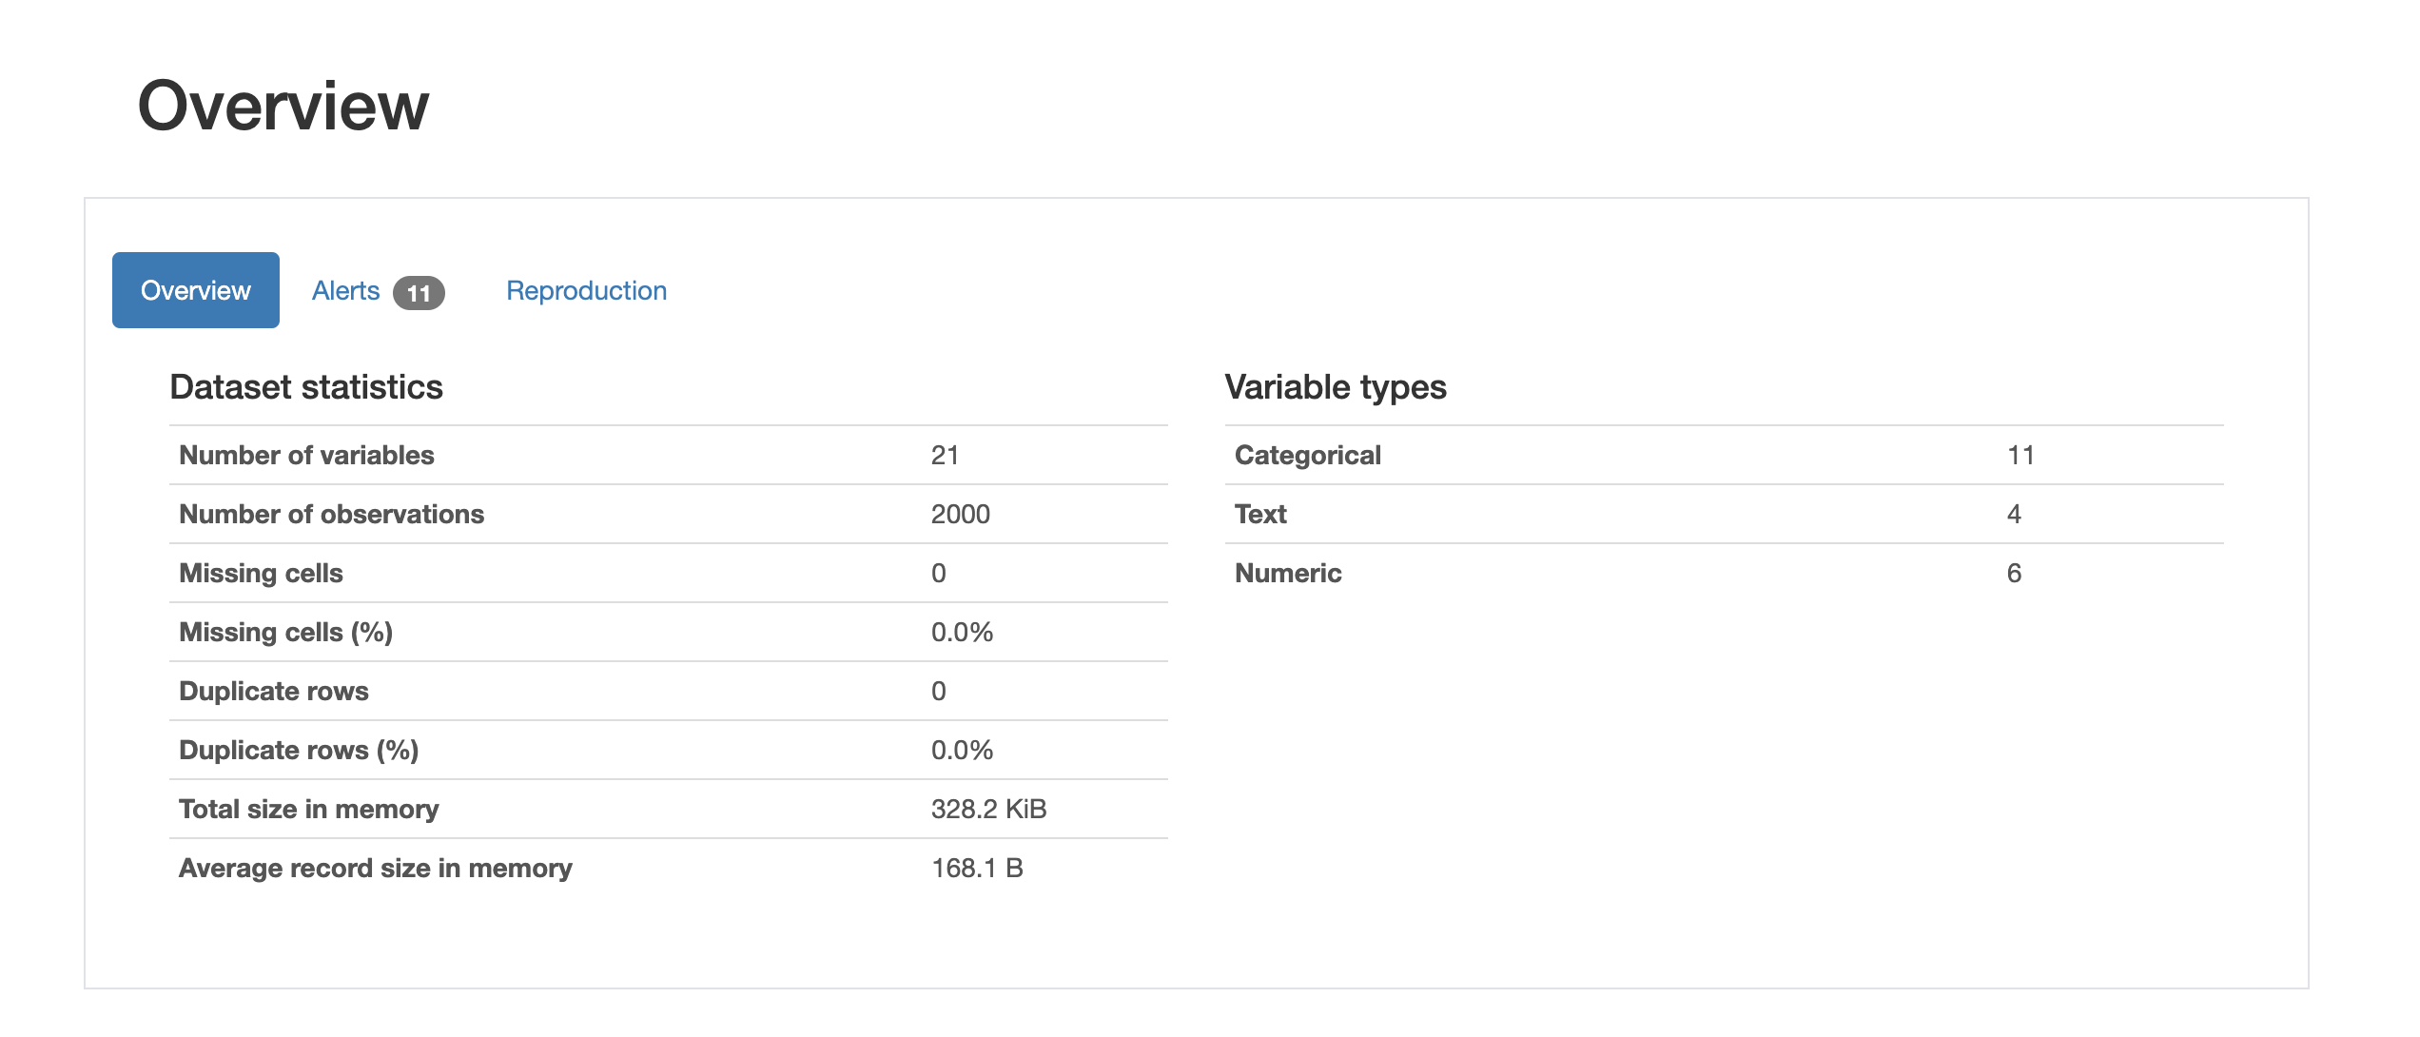
Ydata-profiling- Python Library
Why we chose the ydata-profiling library GitHub: https://github.com/ydataai/ydata-profiling
It provided a quick overview of duplicate rows and null values to aid in cleaning the data.
It presents simple visualizations for the data to aid in creating more in-depth visualizations.

Slide 5
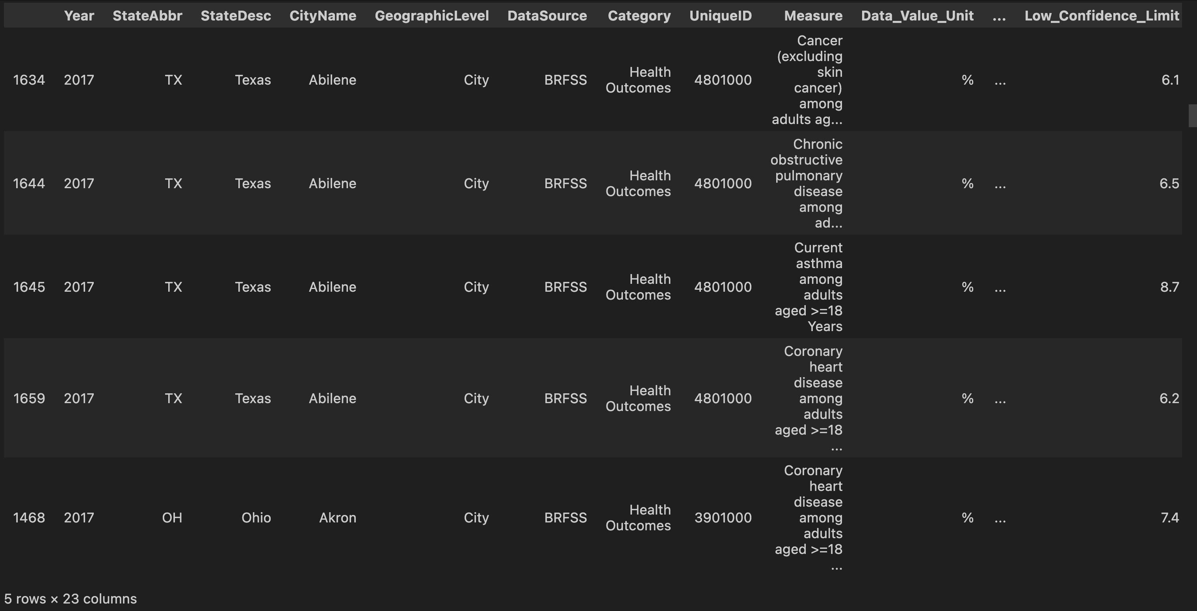
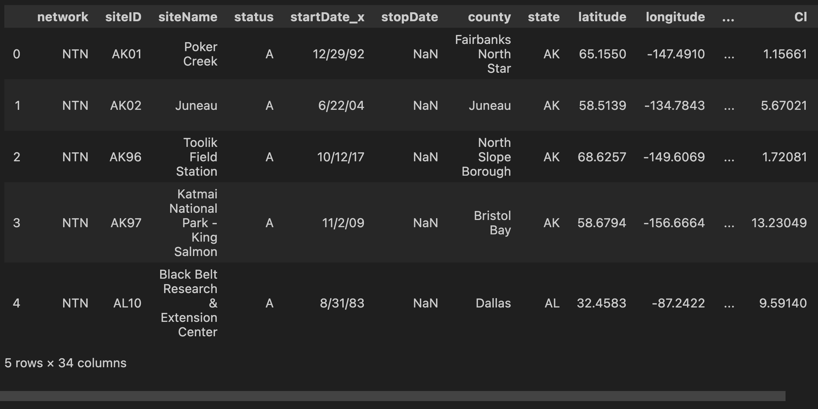
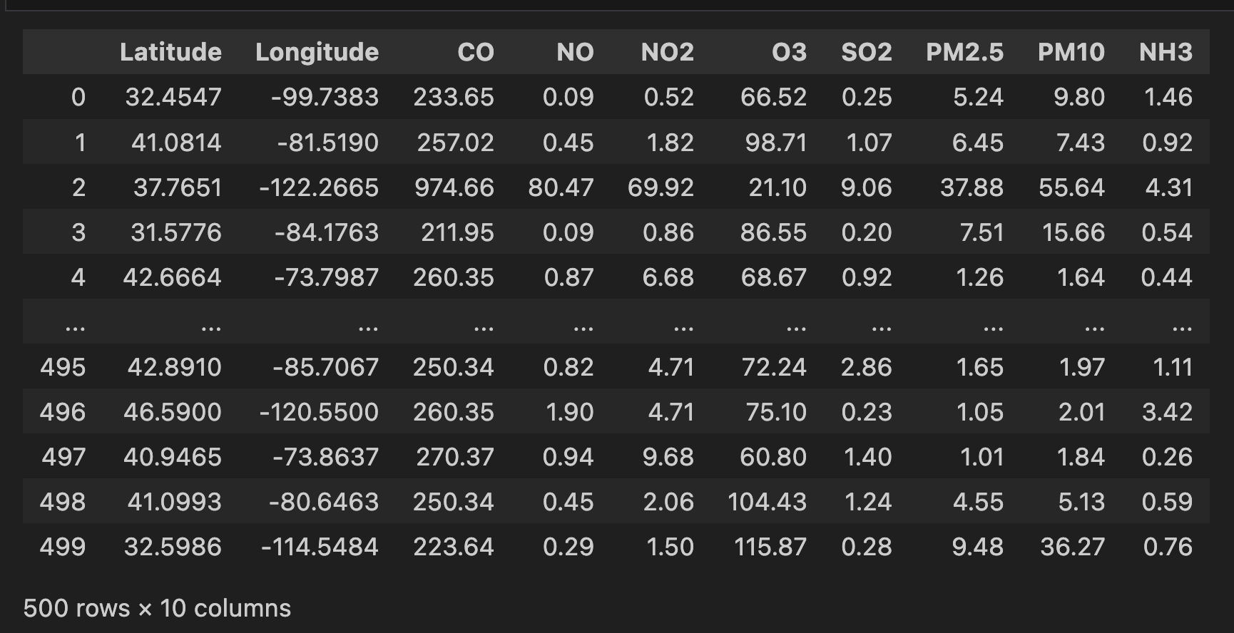
Variables for each DataFrame
CDC 500 Cities
Acid Rain
OpenWeatherMap API

Slide 6
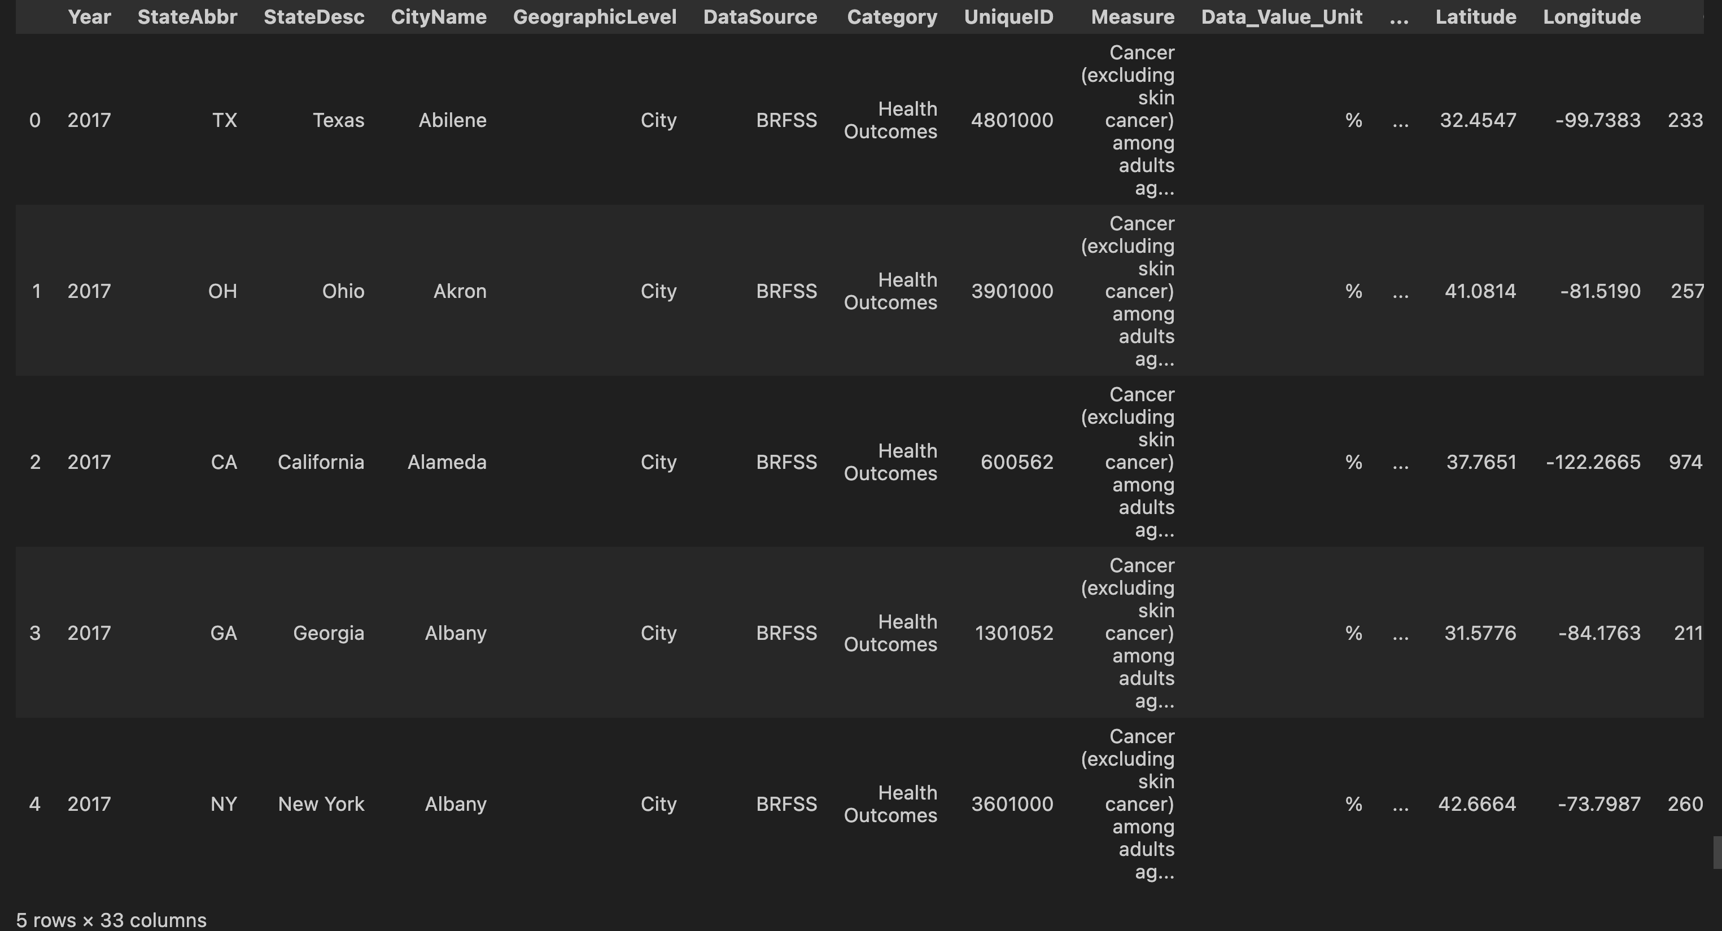
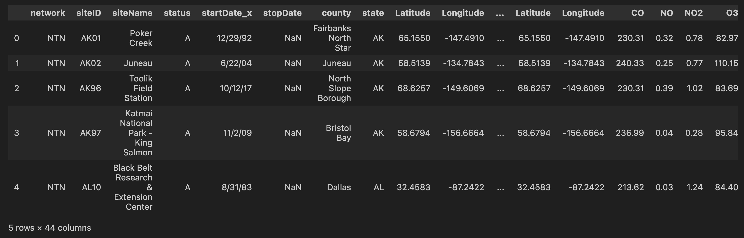
Merging the DataFrames
CDC 500 Cities + API Data
Acid Rain + API Data

Slide 7
Research Question 1: What are the primary sources of air pollution in urban, industrial, and rural areas, and how do they vary spatially and temporally?

Slide 8
Ranges for Pollutants (μg/m³)
Scale | SO₂ | NO₂ | PM₁₀ | PM_{2.5} | O₃ | CO
Good | 0-20 | 0-40 | 0-20 | 0-10 | 0-60 | 0-4400
Fair | 21-80 | 41-70 | 21-50 | 11-25 | 61-100 | 4401-9400
Moderate | 81-250 | 71-150 | 51-100 | 26-50 | 101-140 | 9401-12400
Poor | 251-350 | 151-200 | 101-200 | 51-75 | 141-180 | 12401-15400
Very Poor | >350 | >200 | >200 | >75 | >180 | >15400
NH₃ | NO
Min 0.1; Max 200 | Min 0.1; Max 100

Slide 9
Air Pollutant Dashboard
Showcases Top 500 Cities by Population in the US
Provides the metadata including the state and population count
Bar graph shows the concentrations of pollutants
User can select which cities to visualize pollutant concentrations

Slide 10
Research Question 2: How does air pollution contribute to the incidence and severity of respiratory diseases (e.g., asthma, chronic obstructive pulmonary disease) and cardiovascular diseases?

Slide 11
Map of Diseases and Pollutants
Leaflet Map of Top 500 US Cities by population
Diseases of interest: Cancer (except skin), COPD, Asthma, and Coronary Heart Disease
Color of markers represents pollution concentration (ratio of pollutants over their max summed) from green to red
Size of markers represents the percent of population with a respiratory or cardiovascular disease

Slide 12
Research Question 3?
What sort of impact does air pollution have on wet deposition (acid rain)?
What are the two main chemicals that compose the pollution in acid rain?
What sort of distribution do we see in the US and what does this mean?

Slide 13
Acid Rain Information
Acid rain is primarily formed by the mixing of water and two main chemicals, sulfates (SO4) and nitrates (NO3)
Sulfates are formed by the introduction of water and sulfur dioxide (SO2) emissions, while nitrates are formed by the introduction of water with (NO2) emissions
The main catalyst for this air pollution that results in wet deposition is that of burning fossil fuels. Acid rain can also form as a result of volcanoes, forest fires, and decomposition
On the next slide we shall look at visuals showing sulfate and nitrate distributions

Slide 14
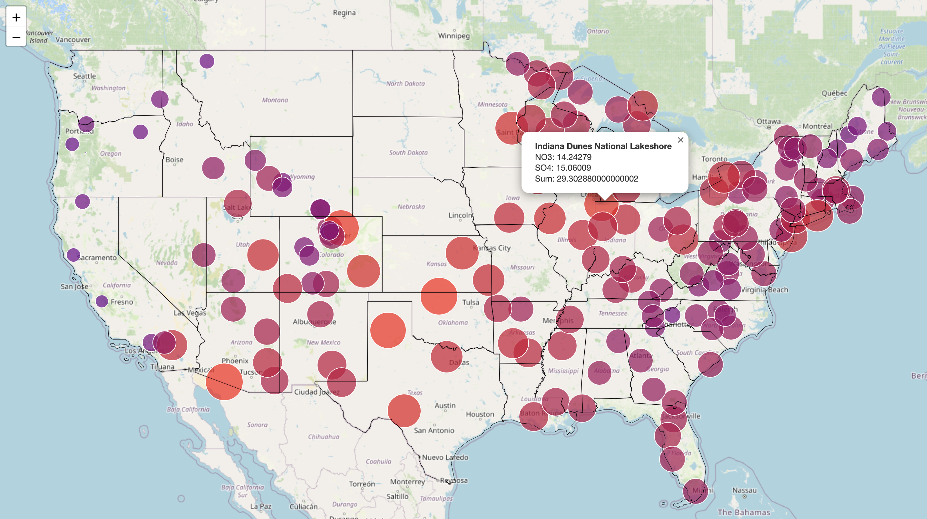
Acid Rain Deposition USA

Slide 15
What does this Distribution mean?
In this interactive map, we can see that major cities have a higher prevalence of wet deposits due to the larger fossil fuel emissions. (Primarily the NE, Chicago, and the SW)
However, we also see a trend of higher wet deposit prevalence in the center of the country, which can be attributed to other factors such as large vehicles and power plants that are used widely in the region. Many of these states also have large oil, coal, and natural gas deposits.
Mountains seem to have an overall lower pollutant level than areas with lower elevation, along with the PNW, which can be attributed to its proximity to the pacific ocean and large amount of rainfall (resulting in lower fossil fuel emissions)

Slide 16
Thank you!

